Slide 1

Gender Equality in Higher Education
Global patterns, South African realities, and the unfinished transformation agenda
A reflective presentation
Joleen Steyn Kotze
Chief Research Specialist: Democracy and Citizenship

Slide 2
Access has expanded, but equality has not “arrived”
114:100
Sub-Saharan Africa
~25%
women enrolled in higher education globally for every 100 men in 2024
the only region where gender parity in higher education enrolment has not yet been reached
women hold only about one-quarter of senior academic leadership roles globally
Reading the pattern
Access
→ Completion
→ Leadership
• Women’s participation has risen sharply, but the “female advantage” at enrolment level hides persistent inequalities by region, level and discipline.
• Parity in headcounts does not automatically change academic cultures, research agendas, career progression or governance.
Reflection point:
The centre of gravity has shifted from “Are women there?” to “Do women have equal power to shape institutions and knowledge?”
The enrolment story is positive; the power story remains uneven.
Women remain underrepresented at the doctoral level (ISCED level 8) even though most students at ISCED levels 6 (Bachelor’s) and 7 (Master’s) are female
Sources: UNESCO reported 114 women per 100 men in higher education globally in 2024 and noted parity gaps in sub-Saharan Africa and senior leadership underrepresentation.
Notes:
UNESCO 2026 global trends update: women now outnumber men globally in higher education; parity in all regions except sub-Saharan Africa; women remain underrepresented at doctoral level and hold about one-quarter of senior leadership roles.

Slide 3
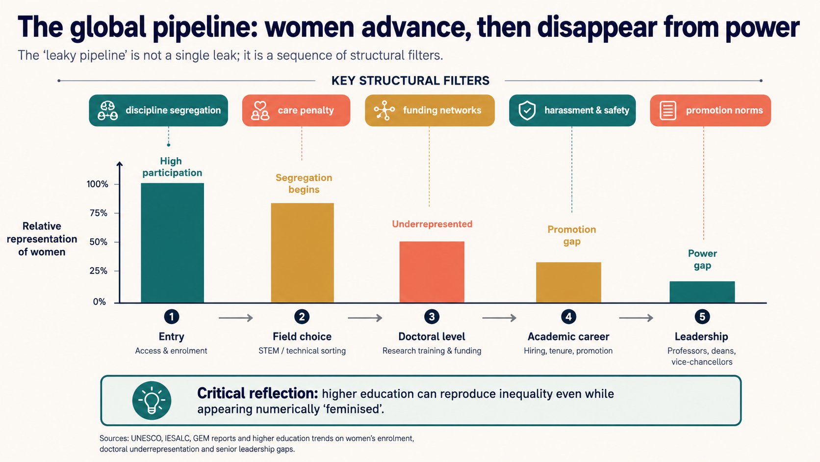

Slide 4
What feminised inequality looks like globally
Regional inequality
STEM and digital divides
Care and time poverty
Institutional Climates
The challenge is intersectional
  Women are not a single category, and “average woman” indicators can conceal deep exclusions.

Slide 5
South Africa: strong female participation, uneven transformation
62.7%
65.4%
Doctorates
Faculty
48.4%
43 % of faculty are female
18.5 % female Professors
29.8% female Associate Professors
of public HEI enrolments were female in 2023
of public HEI graduates were female in 2023
of doctoral students were female
Selected 2023 DHET indicators
Interpretation
female enrolment
• South Africa has moved beyond basic access for women in many parts of the system.
female graduates
• The equality gap is now concentrated in academic authority, doctoral pathways, disciplinary patterns and institutional cultures.
female academics
• Race and gender must be read together: demographic transformation remains uneven across categories and institutions.
Public higher education shows high female enrolment and graduate shares, but postgraduate and staff hierarchies are more complex.
Source: DHET, Statistics on Post-School Education and Training in South Africa, 2023: female enrolment, graduates and staff indicators.

Slide 6
Women are present, but not evenly positioned
A feminised staff total can coexist with male advantage in academic/research roles and senior ranks.
• Several institutions showed skewed representation in top, senior and academic posts, including Professor and Dean levels.
• Employment equity barriers were described as rooted in institutional culture, location, scarce skills and discipline-specific dynamics.
• The question is not only how many women are employed, but where they are located in the academic hierarchy.
Transformation lens: participation → authority → agenda-setting → institutional accountability

Slide 7
Campus climate: equality is also about safety, belonging and care
Reflective provocation
A university cannot claim gender equality through enrolment statistics while unsafe, uncaring or exclusionary institutional cultures continue to shape daily academic life.
Equality is lived in policies, reporting pathways, promotion committees, classrooms, laboratories and residences.

Slide 8
Campus climate: equality is also about safety, belonging and care
A university cannot claim gender equality through enrolment statistics while unsafe, uncaring or exclusionary institutional cultures continue to shape daily academic life.
Equality is lived in policies, reporting pathways, promotion committees, classrooms, laboratories and residences.
Reflective provocation
Safety
GBV and sexual harassment systems must be trusted, visible, survivor-centred and monitored.
Belonging
Policies must include women, LGBTQIA+ persons and gender non-conforming students and staff.
Care
Childcare, flexitime and family-responsibility support shape women’s career progression.
Gender transformation is weakened when institutions treat GBV, harassment and care as peripheral issues
Priority
Sources: Commission for Gender Equality 2023/24 findings and recommendations on GBV, harassment, LGBTQIA+ inclusion, employment equity and care.

Slide 9
From representation to transformation
A stronger agenda asks what institutions do with women’s presence.
1
2
3
4
Count
Locate
Listen
Change
Who is enrolled, employed and graduating?
Where are women positioned by rank, field, race, disability and contract type?
Whose experiences of safety, care, belonging and exclusion are recorded?
Which budgets, rules and accountabilities shift power?
This shifts reporting from “women as beneficiaries” to “gender equality as institutional redesign”.
Synthesis based on global and South African evidence reviewed for this presentation

Slide 10
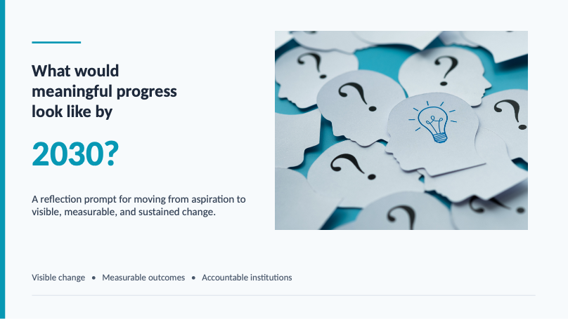

Slide 11
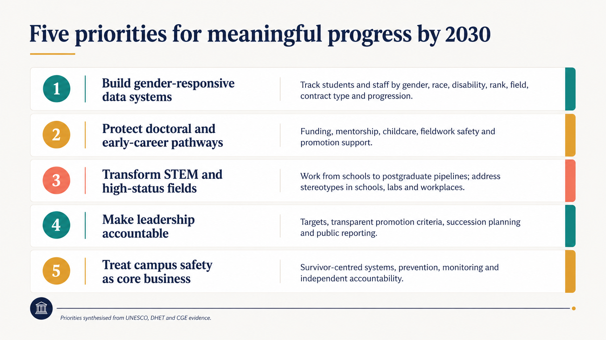
1. Build gender-responsive data systems
Track students and staff by gender, race, disability, rank, field, contract type and progression.
2. Protect doctoral and early-career pathways
Funding, mentorship, childcare, fieldwork safety and promotion support.
3. Transform STEM and high-status fields
Work from schools to postgraduate pipelines; address stereotypes and labs/workplaces.
4. Make leadership accountable
Targets, transparent promotion criteria, succession planning and public reporting.
5. Treat campus safety as core business
Survivor-centred systems, prevention, monitoring and independent accountability.
Priorities synthesised from UNESCO, DHET and CGE evidence.

Slide 12
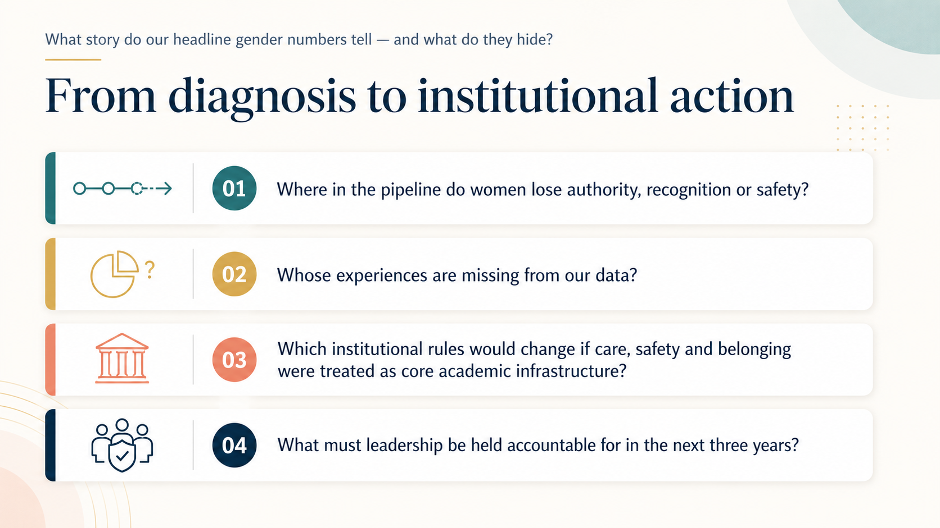
From diagnosis to institutional action

