Slide 1







MAGNETISE ONLINE GENDER EQUALITY
Workshop
CLOSING THE ASPIRATION-IMPLEMENTATION GAP
Informing the Institutional Gender Equality Plan
PROGRAMME DIRECTOR
Ms Thantaswa Tunzi
Social Inclusion & Diversity Manager
Project Number: 101237680
Funded by the European Union. Views and opinions expressed are however those of the authors) only and do not necessarily reflect those of the European Union or the European Education and Culture Executive Agency (EACEA). Neither the European Union nor the granting authority can be held responsible for them.

Slide 2
PROGRAMME
Welcome and purpose of online workshop
Current state of Gender Equality and best practises in HE sector (Globally and South Africa)
Prof Joleen SteynKotze (HSRC)
Overview provided of institutional instruments promoting gender equality
(Policies & Governance structures;
V2030; Institutional Transformation Plan; EE Plan & Report; Academic Performance Plan & Reporting; MERL) – Dr Ruby-Ann Levendal (Nelson Mandela University)
Identify elements of Gender Equality that requires improvement
(breakaway rooms)
Facilitators & Rapporteurs:
Mx Vuyo Ngcofe
Ms Ulleta Marais
Mr Josh Jacobs
Mr Mlondi Bhengu
5 minutes
25 minutes
30 minutes
20 minutes
Funded by the European Union. Views and opinions expressed are however those of the authors) only and do not necessarily reflect those of the European Union or the European Education and Culture Executive Agency (EACEA). Neither the European Union nor the granting authority can be held responsible for them.

Slide 3
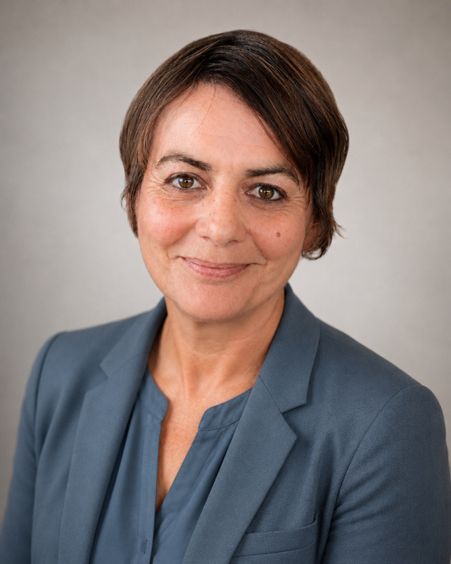
GUEST SPEAKER
PROF JOLEEN STEYNKOTZE
Chief Research Specialist in Democracy and Citizenship
Developmental, Capable and Ethical State Division, HSRC
Research Fellow, Centre for Gender and African Studies, University of the Free State
Funded by the European Union. Views and opinions expressed are however those of the authors) only and do not necessarily reflect those of the European Union or the European Education and Culture Executive Agency (EACEA). Neither the European Union nor the granting authority can be held responsible for them.

Slide 4

INSTITUTIONAL OVERVIEW
Institutional Plans:
  Vision 2030 Strategic Plan (2021 – 2030) (incl. Statement of Commitment to and Inclusive Institutional Culture)
  Institutional Transformation Plan (2023- 2027)
  Employment Equity Plan (2025 - 2030)
  Annual Performance Plan (2026)
Funded by the European Union. Views and opinions expressed are however those of the authors) only and do not necessarily reflect those of the European Union or the European Education and Culture Executive Agency (EACEA). Neither the European Union nor the granting authority can be held responsible for them.

Slide 5
INSTITUTIONAL OVERVIEW - POLICIES
Institutional Policies:
  Equality-Related
    HIV Policy (under review)
    Policy on Gender Equality
    Policy on Persons living with a disability
    Policy on Racism and Racial Discrimination
    Policy on Gender Identities, Expressions and Sexual Orientation (developed and going through approval process)
    Sexual Harassment and Sexual Offences Policy
    Integrated Policy for the Promotion of Equality and the Prevention and Protection Against Unfair Discrimination
Funded by the European Union. Views and opinions expressed are however those of the authors) only and do not necessarily reflect those of the European Union or the European Education and Culture Executive Agency (EACEA). Neither the European Union nor the granting authority can be held responsible for them.

Slide 6
INSTITUTIONAL OVERVIEW - POLICIES
Institutional Policies:
  Equity-Related (Redress)
    Broad-Based Black Economic Empowerment Policy
    Employment Equity, Diversity and Inclusion Policy
Funded by the European Union. Views and opinions expressed are however those of the authors) only and do not necessarily reflect those of the European Union or the European Education and Culture Executive Agency (EACEA). Neither the European Union nor the granting authority can be held responsible for them.

Slide 7
INSTITUTIONAL OVERVIEW - GOVERNANCE
INSTITUTIONAL GOVERNANCE & COMMITTEES:
  Council
  Senate
  Institutional Forum
  Student Services Council
  Employment Equity Forum (EE plan & skills development)
  Engagement and Transformation Committee
    Sexual Harassment and Offences Committee (SHOC)
  Quality Advancement Committee
Funded by the European Union. Views and opinions expressed are however those of the authors) only and do not necessarily reflect those of the European Union or the European Education and Culture Executive Agency (EACEA). Neither the European Union nor the granting authority can be held responsible for them.

Slide 8
INSTITUTIONAL OVERVIEW – GE Survey Feedback
Domain | Mean score | % of max | What it measures
A — Institutional reality | 3.55 / 5.0 | 71% | What staff perceive to be currently true about their institution
B — Attitudes and values | 4.38 / 5.0 | 88% | What staff believe should be the case — normative views
C — Concrete implementation | 3.40 / 5.0 | 68% | Perceived presence of specific GE measures and practices
D — Awareness and engagement | 3.53 / 5.0 | 71% | Participation in, and knowledge of, GE structures and processes
Survey indicator | Mean score | % of max
Gender equality is a priority at my institution | 3.77 | 75%
People of all genders have equal opportunities to access leadership positions | 3.46 | 69%
People of all genders have equal opportunities to access research grants and conferences | 3.95 | 79%
There is gender balance across departments and academic fields | 3.08 | 62%
Gender-related issues can be openly discussed in my institution | 3.28 | 66%
University policies promote an inclusive and respectful environment | 3.88 | 78%
The university provides a safe environment for people of all genders | 3.46 | 69%
Gender equality contributes to improving the quality of education, research, and institutional governance | (rated positively) | —
Funded by the European Union. Views and opinions expressed are however those of the authors) only and do not necessarily reflect those of the European Union or the European Education and Culture Executive Agency (EACEA). Neither the European Union nor the granting authority can be held responsible for them.

Slide 9
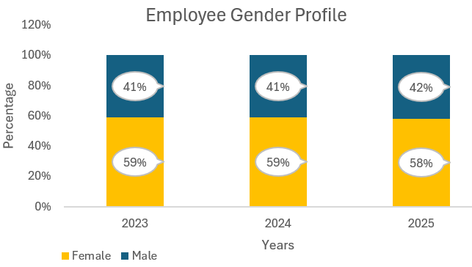
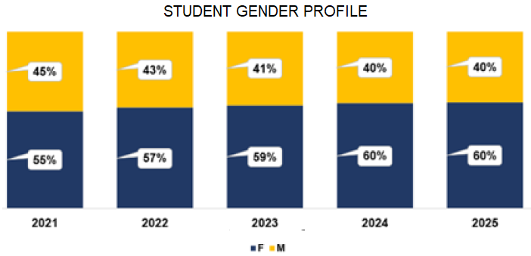
INSTITUTIONAL OVERVIEW – Gender (heteronormative)
Funded by the European Union. Views and opinions expressed are however those of the authors) only and do not necessarily reflect those of the European Union or the European Education and Culture Executive Agency (EACEA). Neither the European Union nor the granting authority can be held responsible for them.

Slide 10
Perceptions on gender equality in your institution
Elements for discussion
  Whether GE is a priority; all genders have equal access to development opportunities
  Gender balance across PASS and Academic positions
  Gender-related challenges are openly discussed
  Policies to support GE
  Work environment is safe space for all genders
1.
Funded by the European Union. Views and opinions expressed are however those of the authors) only and do not necessarily reflect those of the European Union or the European Education and Culture Executive Agency (EACEA). Neither the European Union nor the granting authority can be held responsible for them.

Slide 11
Attitudes towards gender equality in your institution
Elements for discussion
  Whether GE contributes positively towards quality of governance, education, research; executive leadership support of GE initiatives
  gender stereotypes negatively impact recruitment, promotion or leadership opportunities
  challenges behaviours that reinforce stereotypes
  GE initiatives positively impact institutional culture and working conditions
  Training should be provided to academics on how to integrate inclusive language and gender perspectives in their education and research).
2.
Funded by the European Union. Views and opinions expressed are however those of the authors) only and do not necessarily reflect those of the European Union or the European Education and Culture Executive Agency (EACEA). Neither the European Union nor the granting authority can be held responsible for them.

Slide 12
Practices related to gender equality in your institution
Elements for discussion
  Whether inclusive language, integration into the curriculum, research, training and awareness programmes, GE committee, work-life balance with flexibility in conditions of service
  Facilities to support inclusive working; gender equality in recruitment, selection and promotion processes
3.
Funded by the European Union. Views and opinions expressed are however those of the authors) only and do not necessarily reflect those of the European Union or the European Education and Culture Executive Agency (EACEA). Neither the European Union nor the granting authority can be held responsible for them.

Slide 13
Institutional support and policy awareness in your institution
Elements for discussion
  Whether there is a Gender Equality Plan (GEP) in place
  Knowledge of GEP implementation; GE committee and monitoring of the GEP
  Reporting of GE violations, including discrimination and harassment
  Capacity building on GE; MANCO support for GE initiatives; resource allocation
4.
Funded by the European Union. Views and opinions expressed are however those of the authors) only and do not necessarily reflect those of the European Union or the European Education and Culture Executive Agency (EACEA). Neither the European Union nor the granting authority can be held responsible for them.

Slide 14
PLENARY – REPORTBACK BY RAPPORTEURS
Feedback into plenary
10 minutes per breakaway group:
Rapporteurs: 1. Mx Vuyo Ngcofe
2. Ms Ulleta Marais
3. Mr Josh Jacobs
4. Mr Mlondi Bhengu
Way forward
5 minutes
Dr Ruby-Ann Levendal
Funded by the European Union. Views and opinions expressed are however those of the authors) only and do not necessarily reflect those of the European Union or the European Education and Culture Executive Agency (EACEA). Neither the European Union nor the granting authority can be held responsible for them.

Slide 15
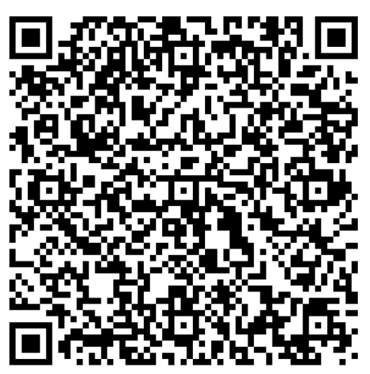
WORKSHOP EVALUATION
Evaluation Survey
Closure
Funded by the European Union. Views and opinions expressed are however those of the authors) only and do not necessarily reflect those of the European Union or the European Education and Culture Executive Agency (EACEA). Neither the European Union nor the granting authority can be held responsible for them.

Slide 16


Slide 17
Thank You
Funded by the European Union. Views and opinions expressed are however those of the authors) only and do not necessarily reflect those of the European Union or the European Education and Culture Executive Agency (EACEA). Neither the European Union nor the granting authority can be held responsible for them.

