Slide 1
Singamadoda?
Redefining Positive Masculinity:
Dan Danisa: Transformation Office

Slide 2
Session 1: Manhood & Vulnerability
Roadmap for Today!
Introductions
Expectations: For the Program
Session overview.
What is Singamadoda? : Background, Objectives, Methods
Activity 1: Defining Manhood
Energizer
Activity 2: Vulnerability is Not Weakness
Closing

Slide 3
Introductions
Introduce yourself to the group by giving us your:
Name/surname
What are you studying/interested in career wise
An interesting fact about your community

Slide 4
Expectations
Each participant to a quick response to the following question
What is it that I know about the program?
What do I want know about the Program?

Slide 5
Session 1: Objectives
By the End of the session; we will
Gain an understanding of the the SRPM program including background, objectives ; and methods
Reflect on our personal understandings of manhood.
Exploring Vulnerability and Self-Love.

Slide 6
““It is true that masses of men have not even begun to look at the ways that patriarchy keeps them from knowing themselves, from being in touch with their feelings, from loving. To know love, men must be able to let go of the will to dominate. They must be able to choose life over death. They must be willing to change.” (Hooks, 2004)
SINGAMADODA? REDEFINING POSITIVE MASCULINITY ₁

Slide 7
What is Singamadoda?
Singamadoda? Redefining Positive Masculinity: Is an equality driven, anti-GBV initiative, for young men, aimed at fostering a safe space to dialogue, exchange ideas and challenge our ways of thinking about manhood, masculinity and gender equality.
The program consists of 4 facilitated sessions, where we engage and reflect on the self, manhood, gender stereotypes and ways of creating healthier and more emphatic.

Slide 8
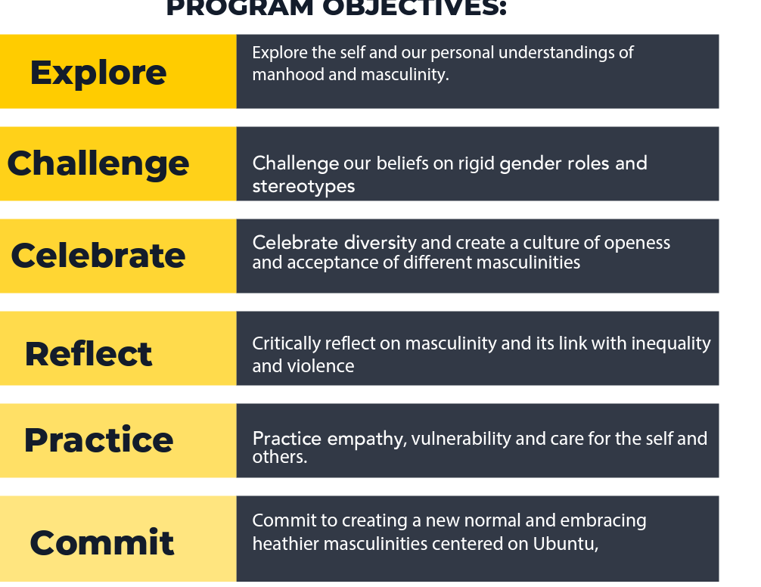

Slide 9
Background: Why this program?
The harsh reality is that, despite the overwhelming benefits patriarchy may afford men in terms, of access, material success, or power and control within the home and broader society, men suffer untold physical, psychological, and emotional suffering due to the rigid and gendered roles, prescribed to them by a patriarchal society. (Clowes, 2013)
From an early age, boys are taught to devalue and undermine their emotional well-being and vital parts of their humanity. (Hooks, 2004)
They are taught that - they are or will be men. Not women. As such they must suppress all parts of themselves deemed feminine i.e deemed ‘weaker’.
This means that for men, when it comes to emotions, including fear, sadness, compassion, and empathy, these are all to be suppressed with anger often seen as the only justifiable emotion that a man may visibly display. (Hooks, 2004)

Slide 10
Background: Why this program?
This damaging behaviour, and the script of patriarchy are taught and reinforced through violent policing from family structures, peer groups, schooling systems, cultural settings, and religious beliefs. (Barker, 2018)
For example, young boys will be shamed by their friends, older siblings and even parents, if they are found playing with dolls, being timid, crying or displaying behaviour deemed too girly.
As such, society tends to raise angry, and emotionally detached men who feel they must assert their manhood – dominance and control at every turn. (Safety and Violence Initiative, 2019)

Slide 11
Background: Continued…
This is not good for anybody. Including Men, Women, Children and the LGBTQ+ Community (Queer)
Patriarchy and beliefs about manhood which are rooted in dominance over others, rigid gender –norms, and a lack of empathy and care are some of the primary drivers of Gender-Based Violence and Homophobic Violence

Slide 12
Background: Continued…
HOW SO???????
(GBV) must be understood within the context of an unequal power structure rooted in the political, economic, and social marginalization of women.
It persists through language, attitudes, and behaviour that portrays and treats women as objects, having less value, and intrinsic worth then men.
Men’s perpetration of violence is a fundamental element of gender inequality, and men’s use, and experiences of violence are upheld through our attitudes, beliefs, and behaviours about manhood/masculinity

Slide 13
THIS IS NOT A LECTURE!!!!!!
This is a co – learning space!
Through activities, role playing and illustrations we are going to work on this thing together.
Throughout each session, we will constantly engage and challenge each other to unlearn, relearn and grow together

Slide 14
It’s not going to be easy!
They’ll be ups and downs
We are going to disagree
We’ll get emotional
It may be intense
But if we respect each other and are sincere in our approach,
There is a lot to be gained from the program.

Slide 15
QUESTIONS SO FAR?

Slide 16
Activity 1: Define Manhood
In 30 seconds or less each participant must give their personal definition of manhood.
You have two minutes to think about it.
Then I will select a participant at random to answer

Slide 17
Activity 1: Discussion (20min)
*possible discussion points*
Do We all agree?
Is manhood biological or social?
Can it change?
What about cultural differences?
What about fashion choices?
Anything else raised by participants
* these are just suggestions to stimulate discussion*
The main point of this exercise to introduce the idea that the are many masculinities i.e there are many ways of being a man and we can’t be rigid in defining it for ourselves and others

Slide 18
Activity 2: Exploring Vulnerability (20min)
Each participant to note or think about one/all of the following points. Asking themselves the questions listed under each topic. * Participants get 7 – 10min to think, and can share whatever they are comfortable with
Someone they Love
why do you love them?
how do they show love to you?
How do you show love to them?
2. Something they Fear/worry about
what about it makes you anxious?
How do you deal/cope with it?
3. The last time they were sad/hurt.
How did you express that sadness?
Did you ever speak to someone about it? Why/why not?

